Slide 1

Factors Affecting Car Prices Mini Project #1
DAVID MUWANDI
6 Feb. 2021

Slide 2
Business Question
What factors affect car price?

Slide 3
Why ask this question
Pricing may be used to structure a business model and maximise sales margins.
Insights on which vehicles are selling may be used to optimise vehicle stocks by car traders and improve cashflow and profit.

Slide 4
Used car industry in the USA
Annual sales of over US$350 billion
Represents half of the U.S. auto retail market and is the largest retail segment of the economy.
In 2019, about 40.8 million used cars and trucks were sold in the United States.

Slide 5





Pipeline
DATA
CLEANING & EXPLORATION
DATA
ACQUISITION
VISUALISATION
HYTOTHESIS
PRESENTATION

Slide 6
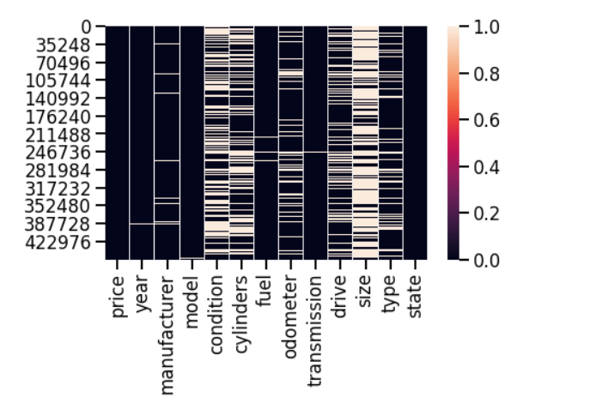
Data Set
Cars listed on Craigslist (United Sates) in Jan 2021
BEFORE CLEANING
458 213 Observations
26 features
AFTER CLEANING
198518 Observations
12 Features

Slide 7
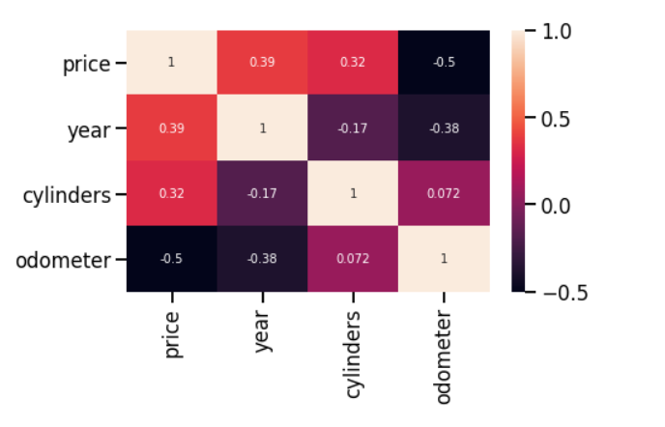
Numeric variable correlation
Price to odometer
-0.5 Corr the lower the odometer the higher the price
price to Cylinders
0.32 Corr : price increases with increase in number of cylinders
Price to Year
0.39 Corr : newer vehicles will cost more

Slide 8
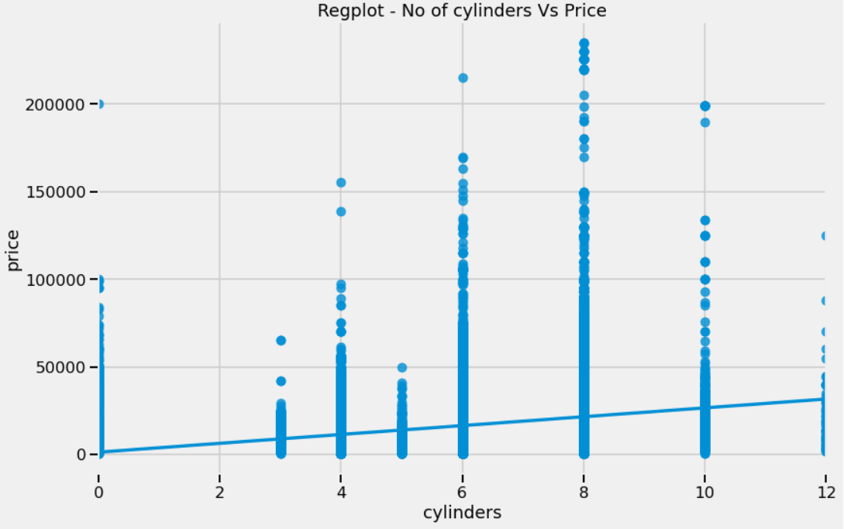
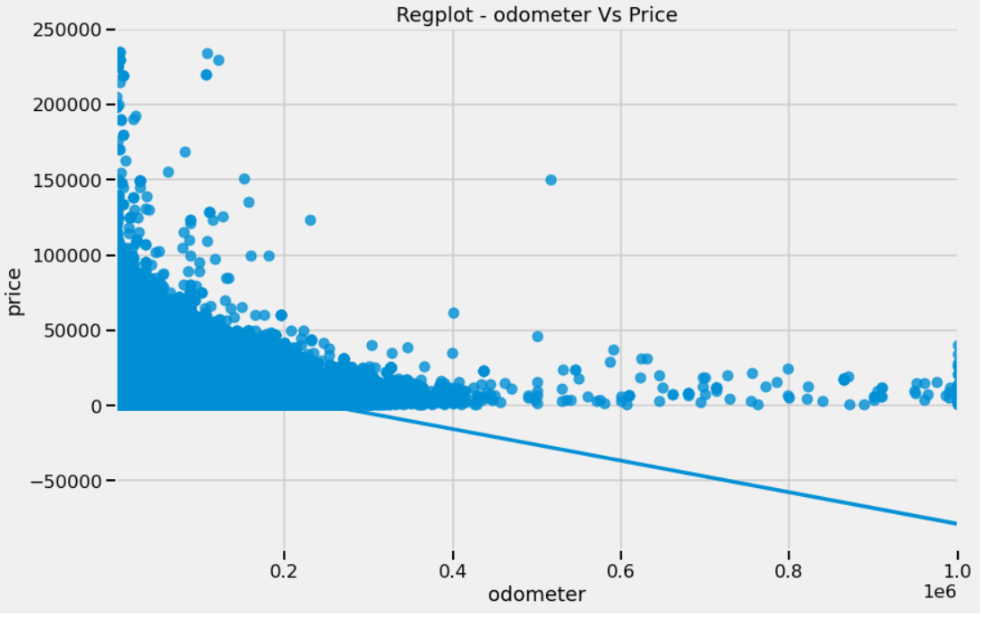
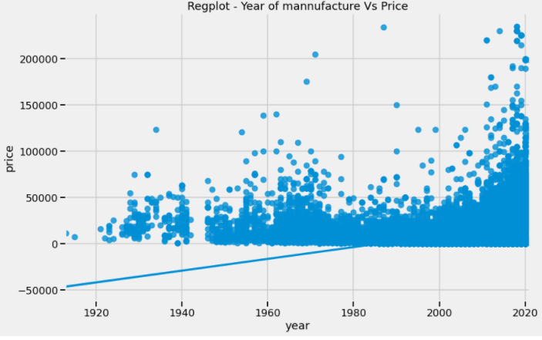
𝑦̂ =𝛽0+𝛽1𝑥
𝑦̂ =1253.25+2529.4𝑥
𝑦̂ =𝛽0+𝛽1𝑥
𝑦̂ =26303.16 - 0.105𝑥
𝑦̂ =𝛽0+𝛽1𝑥
𝑦̂ = -1262656 + 635.96𝑥

Slide 9
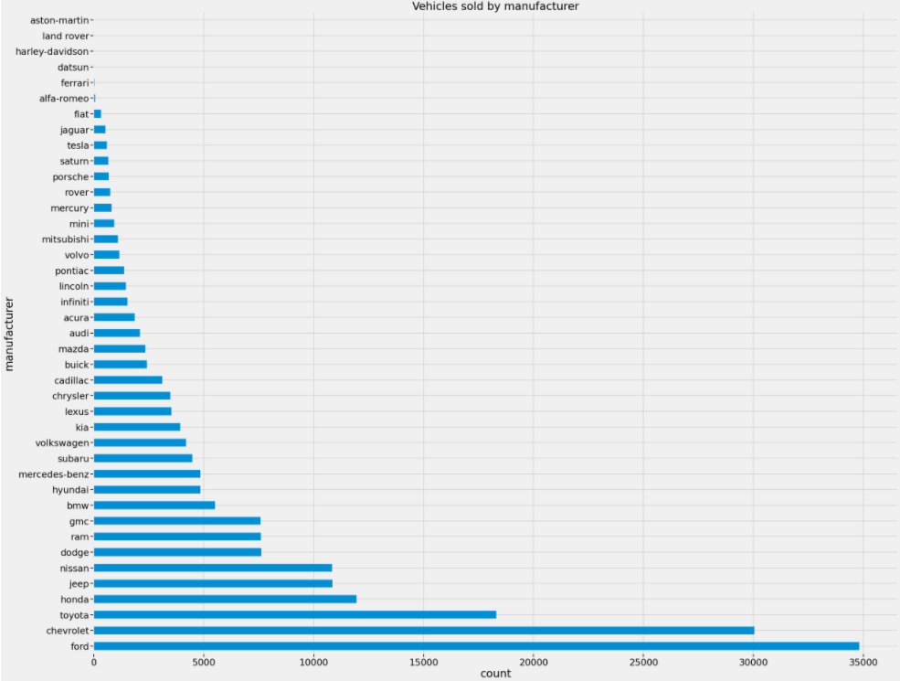

Slide 10
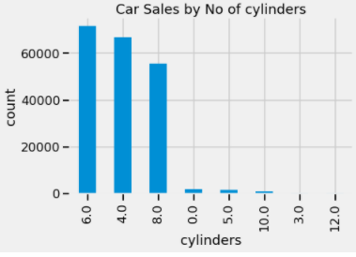
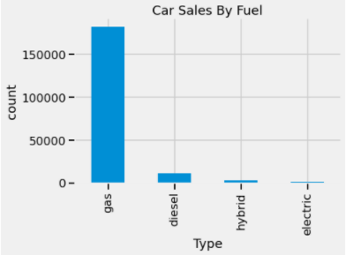

Slide 11
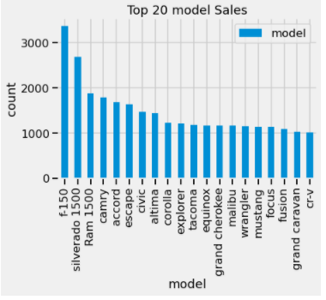
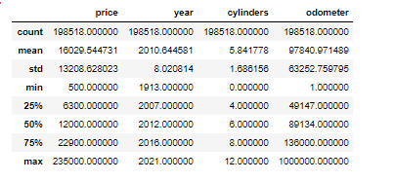

Slide 12
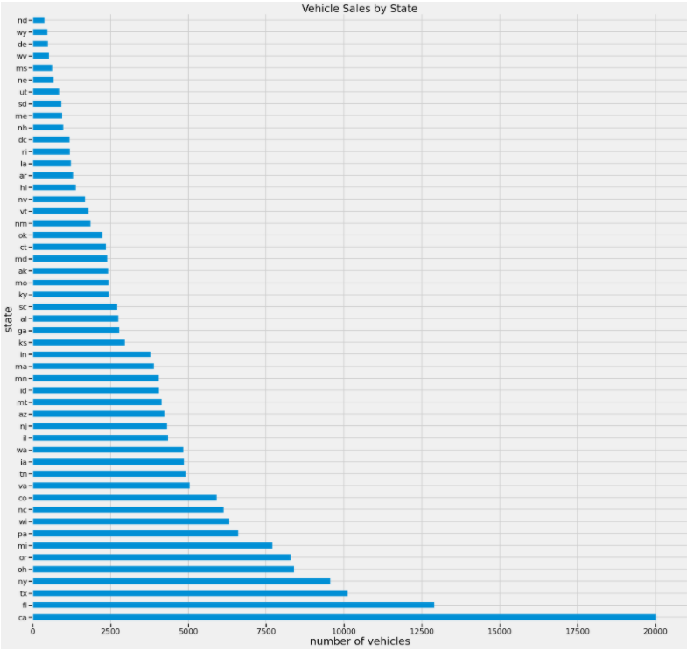
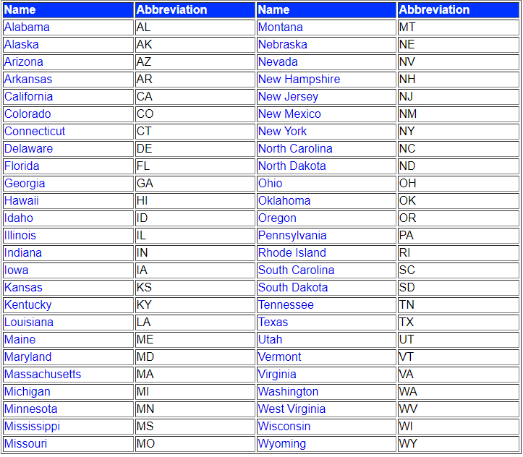

Slide 13
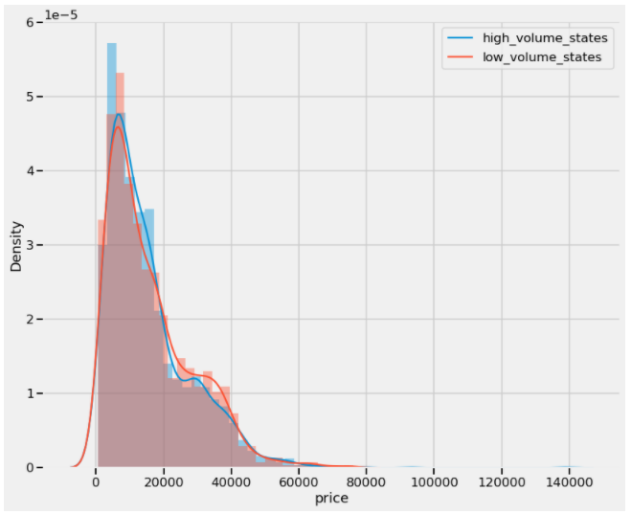
Hypothesis testing
Ho - The number of cars traded in a state does not affect vehicle price
H1 - The number of cars traded in a state affects vehicle price
Significance level : 5%
t = -1.3422
P = 0.178
Conclusion: Reject H0
The number of cars traded in a state does not affect price

Slide 14
Business Answer
Year of manufacture and number of cylinders increase with price.
Price decreases with increase odometer/milage
price is not affected by the number of vehicles traded

Slide 15
Further insights
California, Florida, Texas, New York have highest car sales
Ford, Chevrolet, Toyota, Honda are the most popular Manufactures
The top 3 models selling are trucks f-150, Silverado 1500 & ram 1500
Camry, Accord, escape, civic and Altima are the highest selling sedans
6 cylinder gas engines are the most sold engine variant.
75 % of vehicles sold are less than 136000 miles

Slide 16
Summary
The business now understands
The benefits
Which factors affect car prices
Which states to trade for better price
Which types of vehicles will sell quickly
Improved pricing model
Save time by quickly identifying vehicles of interest
Optimising stock by trading in vehicles which are likely to sell quickly
Improved cashflow and profitability

